Slide 1
Virtual Private Networks
Jacob John Williams
15008632

Slide 2
Historical Context
Why should you use a VPN?

Slide 3
The Rise of Virtual Private Networks
VPNs have existed for a long time, but only recently become widespread.
Point to Point Tunneling Protocol (PPTP) was created in 1996.
The current VPN market has adapted to fit current necessities.
There are broadly two forms of VPN seen generally:
Home Network / Traffic Obscurity, e.g Nord, Express, etc
Remote Network Access.
We will be focusing on the latter.
Notes:
The “first” vpn protocol created in 1996 as Point to Point Tunneling Protocol (PPTP).
Recent years have seen the differentiation between two types of VPN.
One that allows you to obscure your browsing activity, stopping your Internet Service provider from viewing your traffic and preventing the use of aglomerated data by third parties.
Then the other, more akin to the original concept is Remote Network Access, which we will be focusing on.

Slide 4
Remote Network Access
There are a few reasons for the rise of Remote Access.
Companies are becoming more geographically seperate.
Office costs.
Widespread distribution.
Data gathering nodes Vs Central Offices.
Remote workers are becoming more common.
Day in / Day out office workers.
“In the field” workers.
Consultants.
Remote care nurses.

Slide 5
Our Virtual Private Network.
The how, and the why.

Slide 6
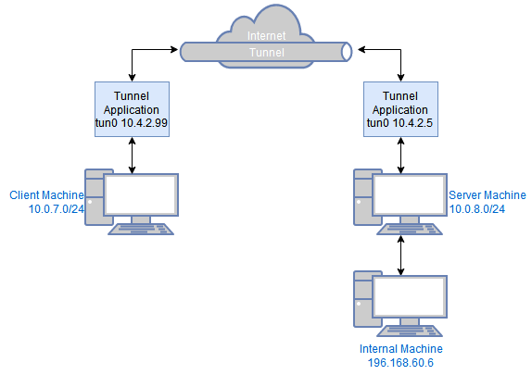
Establishing the Connection.
Our VPN works in a client gateway format.
A public facing computer within the private network will act as the gateway.
Running the client on the external device will allow you to connect through the gateway.
Both the client and gateway work through a Virtual TUN interfaces.
There are two ways to connect, UDP and TCP.
TCP is the primary method of connecting,
since it is more secure thanks to the use
of TLS.

Slide 7
Encryption / Server Authentication
Using a TCP connection we can utilise Transport Layer Security (TLS).
During the establishing of the connection, two key security features occur.
Firstly the client and server determine a common encryption method, allowing all traffic between the two to be encrypted.
Secondly, the client can authenticate the server using certificates, the Public Key Infrastructure.

Slide 8
Client Authentication
The VPN authenticates the client by requiring the entry of the gateway machines username and password.
This way only those within the company should be able to login.
This does however rely on the company having an adequate password policy, and for the remote users to be careful in how they use or remember the password.

Slide 9
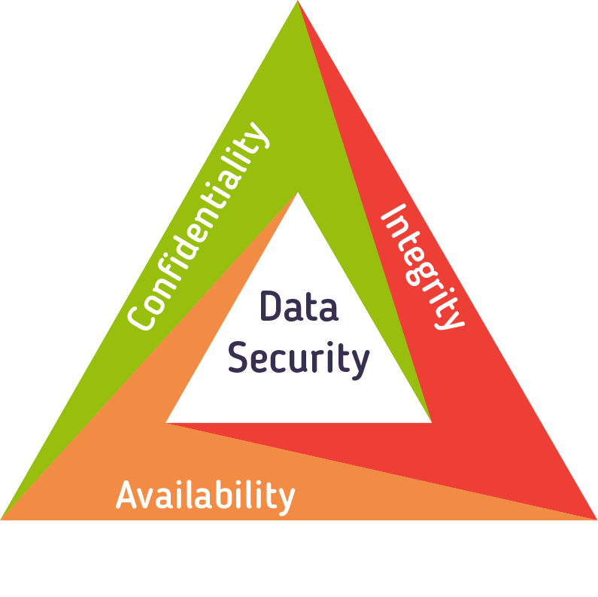
Guarantees
By utilising TCP in conjunction with TLS, and as a result, Public Key Infrastructure allowing the authentication of servers combined with the self implemented client authentication, we can guarentee:
Confidentiality.
Integrity.
Availability.

Slide 10
Planned Features
Whats next?

Slide 11
UDP / DTLS
UDP connectivity is already available on the VPN, however it is significantly less secure than TCP/TLS.
In the future, we plan to integrate the Datagram Transport Layer Security protocol into the existing UDP functionality.
DTLS is to UDP, as TLS is to TCP.

Slide 12
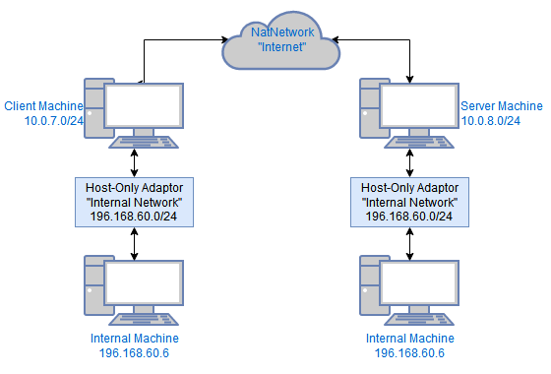
Gateway-to-Gateway
At current, our VPN system works with external clients connecting to the internal network via a single gateway.
By modifying already established connectivity routines, it will be possible to establish a Gateway-to-Gateway connection.
This would essentially allow the secure conjoining of two geographically seperate networks.

Slide 13
Questions?

